Slide 1
Biology Week Quiz 1 ages 13-15

Slide 2
Question 1
True or False:
Some species of fungi glow in the dark

Slide 3
Question 2
How many stomachs does a cow have?
1
2
3
4

Slide 4
Question 3
Can you match these three famous scientists to their areas of expertise?
Watson and Crick
Edward Jenner
Jane Goodall
Creation of vaccines
Structure of DNA
Primatology

Slide 5
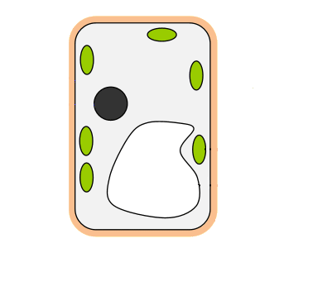
Question 4
Name the structures of this plant cell
Cell wall
Vacuole
Cytoplasm
Chloroplast

Slide 6
Question 5
If you work as an endocrinologist, what do you specialise in?

Slide 7
Question 6
What percentage of each gas is our atmosphere made up of?
Nitrogen
Oxygen
Argon
78%
1%
21%

Slide 8
Question 7
True or False:
Some mammals lay eggs

Slide 9
Question 8
What percentage of human DNA is identical in every individual?
0.1%
45%
99.9%

Slide 10
Question 9
Which animal group contains the largest number of individual organisms?

Slide 11
Question 10
Approximately how many more bacterial cells are there in your body than your own cells
1.5 times more
5 times more
10 times more
100 times more

Slide 12
Question 11
Which of these native UK flowers is poisonous to animals?
Buttercup
Bluebell
Snowdrop

Slide 13
Question 12
What is the common name for the species Panthera leo?

Slide 14
Question 13
In cold weather, in humans and animals, hairs stand on end to trap ________

Slide 15
Question 14
The oldest tree in the UK is the Fotingall Yew in Perthshire. How old do you think it is?
500-900 years old
1000-2750 years old
4000-9000 years old

Slide 16
Question 15
What is the smallest measurement a light microscope can see?

Slide 17
Question 16
Approximately how many species of lizards are there in the world?
Less than 1000
1000-2000
3000-6000
Over 6000

Slide 18
Question 17
What does an ichthyologist study?

Slide 19
Question 18
True or false:
Elephants are herbivores

Slide 20
Question 19
Which species has the greatest number of genes?
Chimpanzees
Humans
Mice
Rice

Slide 21
Question 20
What did Sir David Attenborough study at university?

Slide 22
How did you do?
Tag us on social media using the hashtag #BiologyWeek to let us know!
Love biology? Interested in becoming a member?
Email membership@rsb.org.uk
Thank you for helping us celebrate Biology Week!
27

